Slide 1

Medussa
WOMEN SAFETY APPLICATION

Slide 2
01
02
03
Problem Statement
Objective and Scope
Introduction
contents
04
05
06
Methods Used
Sample Code
Output and uses

Slide 3


Women's safety apps, as the name suggests, are apps that help women feel safer. People have developed a number of women's safety apps based on their own or loved ones' experiences. Most apps assist users in notifying friends and family when they are in trouble. Other apps provide information about nearby medical facilities, navigate the safest route, track options, identify crime hotspot areas, and perform a variety of other functions.
The app's target market is large enough to attract millions of downloads. However, the motivation for developing women's security applications extends beyond monetary gain. It is more akin to making a societal contribution to rate reduction of crime against women.
Introduction

Slide 4

Problem Statement
India has an abhorrent track record in all forms of sexual exploitation, ranking among the worst countries in terms of crime. In homes, on the street, on public transportation, and even in offices. Indian women are constantly on high alert, much like a country on high alert for terrorists. There have been gruesome cases of toddler rapes, gang rapes of eight-year-olds, and women trafficking. We should be ashamed that we have created a society in which women are learning to cope with existential anxiety.

Slide 5

Objective
In order to provide Indian women a sense of security and empowerment, we are concentrating on developing an efficient, quick, and reliable method. For women, our platform will serve as a constant source of support and companionship, ensuring that they never feel abandoned in the midst of a crisis. It will bring the people of India together and make it possible for the police to collaborate on a common issue. The police will be able to prevent crimes against women with the use of this technology, which will serve as their eyes and ears. This tool has been created in a way that it covers the different situations a woman can find herself in, such as when she's by herself or in a busy area.

Slide 6
An essential component of a women's safety project that seeks to stop violence against women and offer support to women is saving the phone numbers of important family members in nearby storage. Women may be able to easily get the contact details of dependable relatives who can provide assistance and support when needed thanks to this function.
A useful addition to a project aimed at improving women's safety could be the ability to call and send messages with real-time locations by shaking the phone three times. This can be particularly useful when a woman feels threatened or uncomfortable and has to quickly and covertly ask for assistance.
Scope
Encouraging the purchase of women's safety equipment from small business owners can be an important scope for a women safety project. This can not only support local businesses and entrepreneurs, but also provide women with access to quality safety equipment that meets their specific needs.

Slide 7

Android OS
Android OS, or Android Operating System, is a software platform designed primarily for mobile devices such as smartphones, tablets, and smartwatches. It is an open-source operating system, which means that its source code is available to developers and can be modified and customized according to their needs.
platforms

Slide 8

Eclipse for android devs
Eclipse is an Integrated Development Environment (IDE) that is commonly used by Android developers for writing, testing, and debugging Android applications. It is an open-source platform that provides a range of tools and features to simplify the app development process.
platforms

Slide 9

Hardware Requirements
1. PROCESSOR : Dual core Processor and above
2. RAM: 1GB and above
3. HARD DISK : 50 GB and above

Slide 10
Methods
JAVA
SQLite Database
Geolocation API
SMS Manager API
Telephone manager API
Accelerometer
Implicit intents for sms, call
Broadcast Reciever

Slide 11
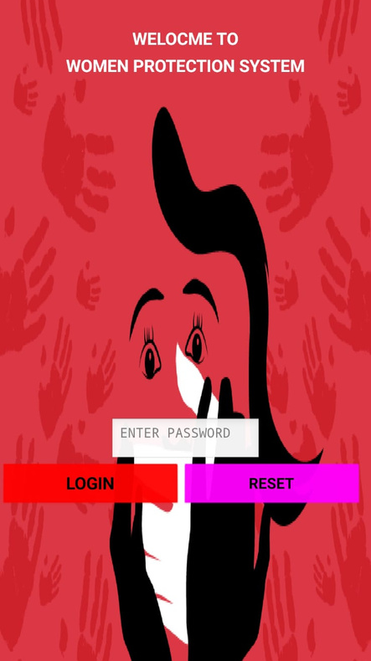
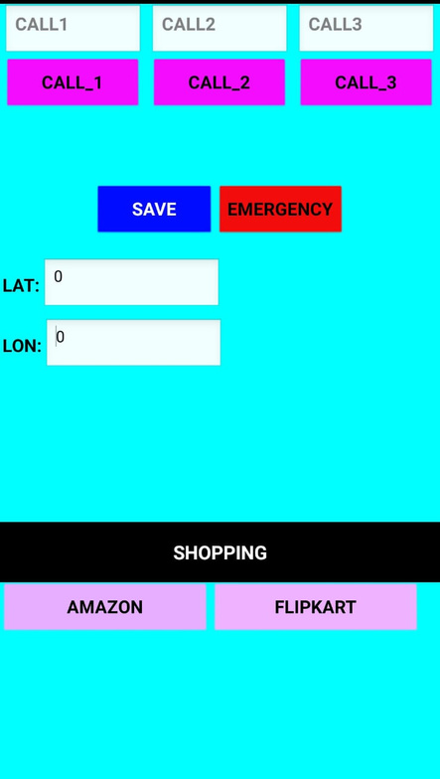
output

Slide 12

Uses
Emergency alerts
GPS tracking
Panic button
Safety tips
Resources

Slide 13

THANK YOU
Sai Vindhya Tenneti (120106008)
Prathapagiri SreeVeda (120106031)
Md Abu Sufiyan Ahmed (120106051)

